Slide 1
The Pigeonhole Principle
Nathaneil Magtangob
CS 131 Discrete Structures – Yuen Y. - Spring 2022

Slide 2
Definition of the Pigeonhole Principle
The principle states that if there are more pigeons than pigeonholes, then there must be at least one pigeonhole with at least two pigeons in it
In layman's terms the principle states that if there are less containers than objects present, then there must be at least two of the objects in the same container

Slide 3
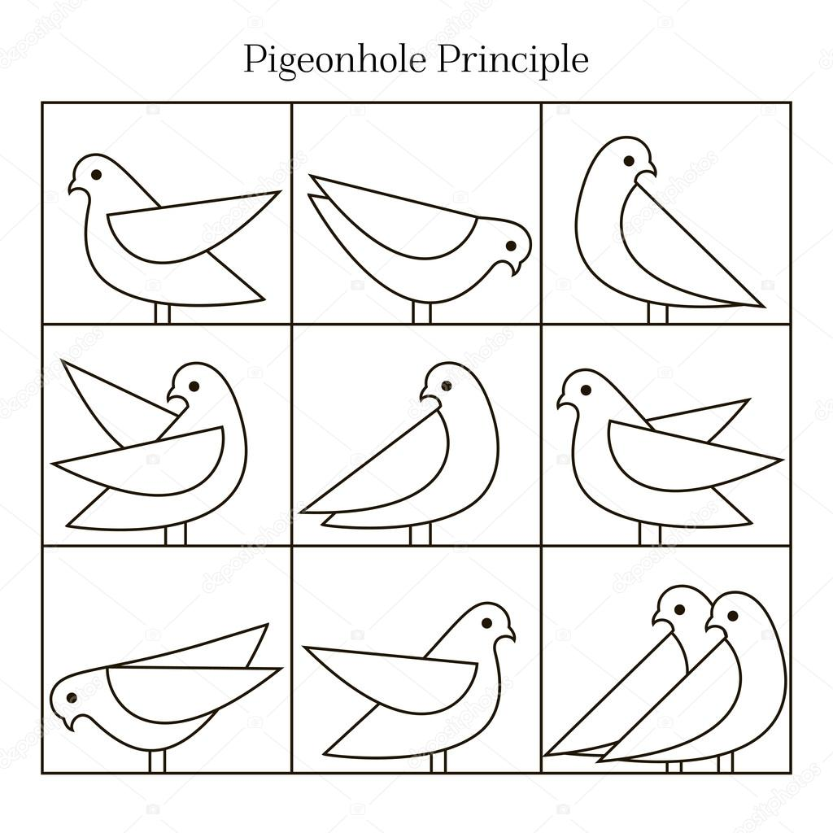
Visual Example of the Principle
In this visual you can see that there are 9 pigeonholes and 10 pigeons.
Since there are more pigeons than there are pigeonholes, this results in at least one of the pigeonholes holding at least two pigeons

Slide 4
Origin of the Pigeonhole Principle
In some cases, the pigeonhole principle is referred to as the Dirichlet drawer principle
This name of the principle is in homage to a 19th century German mathematician G. Lejeune Dirichlet who would frequently use the principle in his work
Although Dirichlet was not the first one to use the principle, as the first recorded use of the principle was by a French mathematician in the 17th century, he is often associated with the pigeonhole principle

Slide 5
Pigeonhole Principle Theorem and Proof
Theorem
If k is a positive integer and k + 1 or more objects are placed into k boxes, then there is at least one box containing two or more of the objects
Proof
The pigeonhole principle is proven through contraposition
Suppose none of the k boxes contain more than one object
This then causes the total number of objects to be at most k
A contradiction occurs, since there are at least k + 1 objects

Slide 6

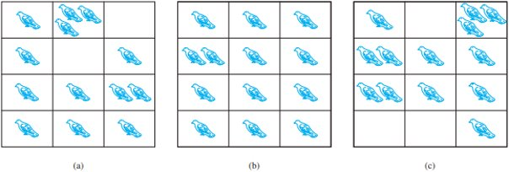



Visual Examples of the Principle

Slide 7
Pigeonhole Principle and Hashing
Hashing and hash tables
Hash tables are a data structure which associates keys with values
The main operation it is used for is lookup using a given key (such as a person's name) followed up by finding a corresponding value (such as a person's birthday)
Hashing works by transforming the key by using a hash function into a hash
A hash is a number which is used to index into an array to find the desired location where the values should be
Theoretically a good hash table should have an individual, unique location for each hash

Slide 8
Pigeonhole Principle and Hashing
Hashing extremes
The worse-case scenarios for hashing is if there was only one location for all the individual hashes making the hash function very inefficient
The best-case scenarios for hashing is if there was a separate unique, individual location for each of the individual hashes making a perfect hash function
Relationship between the pigeonhole principle and hashing
When using hashing you want to ideally avoid the pigeonhole principle as it can make the hash function inefficient as shown by the above examples
The pigeonhole principle is a concept that causes collisions in hashing as when there are more than one hash in a location it results in a collision in that hash table

Slide 9
Pigeonhole Principle and Hashing
Relationship between the pigeonhole principle and hashing
Generally, the only issue the pigeonhole principle causes for hashing is making it more inefficient which is not much of an issue if you are not relying on the hash to be unique
The pigeonhole principle can even cause further issues for hashing if you were to rely on hashing to make a unique digital fingerprint such as a password as it could compromise the security of the hash and make it easier to find the inputs that hash for a specific output

Slide 10
General Examples of the Pigeonhole Principle
Picking 5 cards from a standard deck of 52 cards, results in at least two of the cards being from the same suit
In a novel, for every 27-word sequence in a chapter, at least two words will start with the same letter
In a theater at least containing 677 seats, at least two of the people attending will have the same first and last initials

